Slide 1


“Solution to inconsistent sampling of phylogenetic trees”
Joris Damhuis
Tom Dekker
Supervisor: Richel Bilderbeek

Slide 2
Explain BD model

Slide 3
Explain PBD model

Slide 4
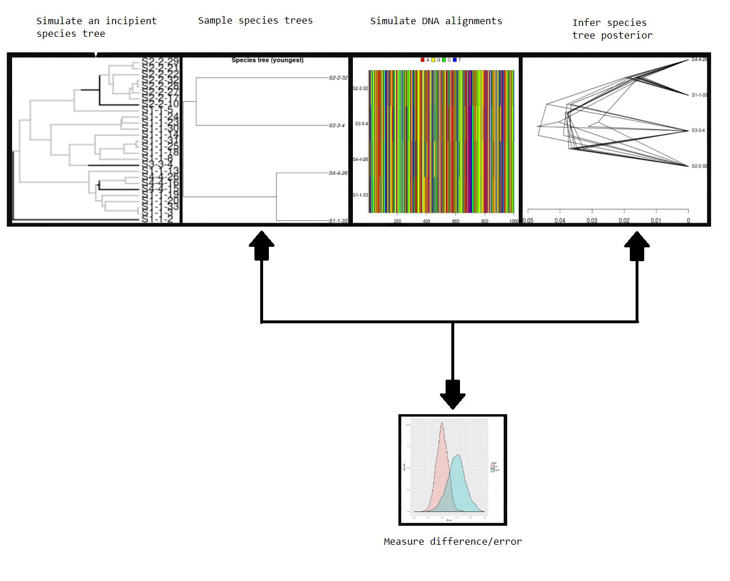
What does the raket package do?
Create parameter files
Simulate a PBD tree
Sample a good species tree from incipient species tree
Generate a DNA alignment from the good species tree
Simulate BD tree from the DNA alignment -> posterior
Compare both simulated trees using nLTT statistics
Change steps to have more biological meaning What do the nLTT values mean? Change picture and perhaps add results peregrine runs there

Slide 5
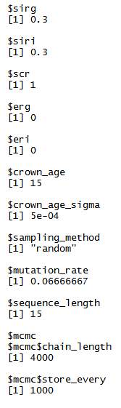
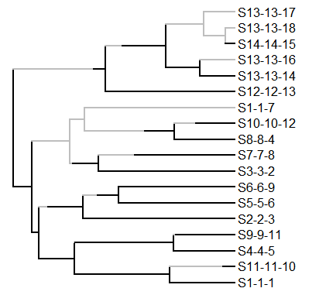
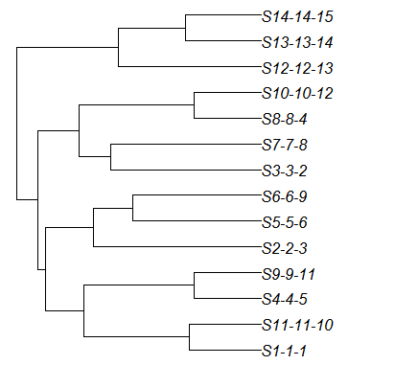
Input file
Incipient species tree
Good species tree

Slide 6
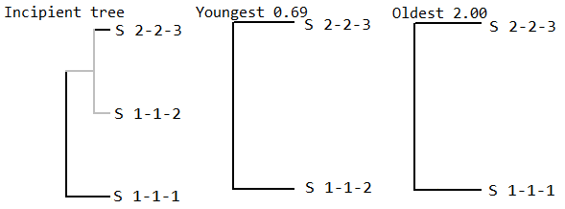
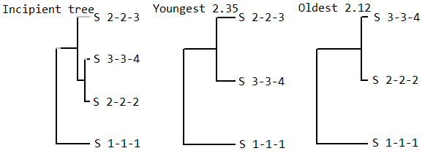
The problem with sampling methods ‘youngest’ and ‘oldest’
Why we need to sample
Why we want to sample the extremes
Expectations

Slide 7
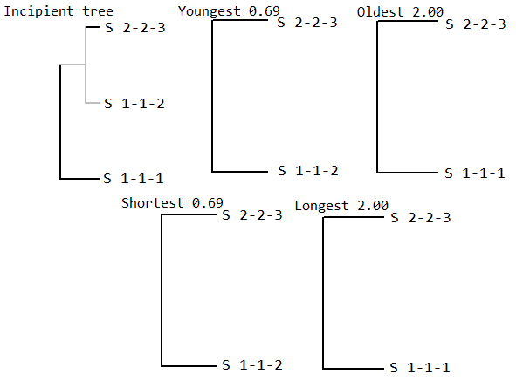
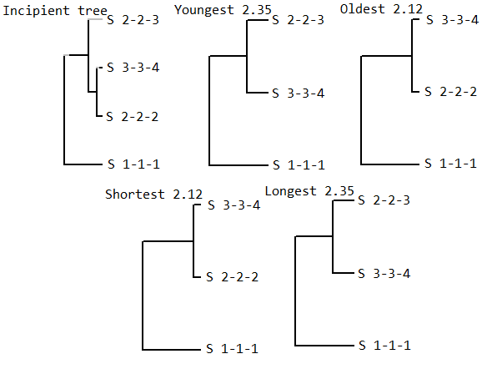
Added sampling methods ‘shortest’ and ‘longest’

Slide 8
Discussion
Bigger picture (conservation implications)
Example giraffes

